Slide 1
What Is Computer Science?

Slide 2
"Computer science is as much about computers as astronomy is about telescopes."
- Edsgar Dijkstra

Slide 3
Computer science
=
How can we use computers to solve problems?

Slide 4

What kinds of problems?

Slide 5
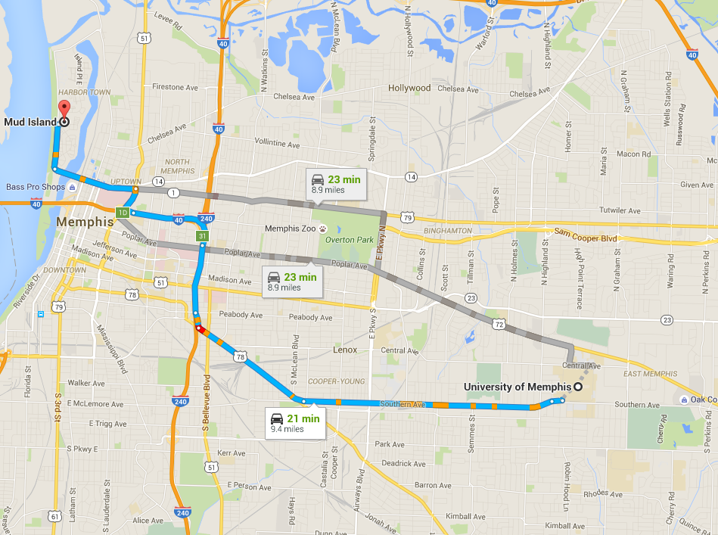

Slide 6
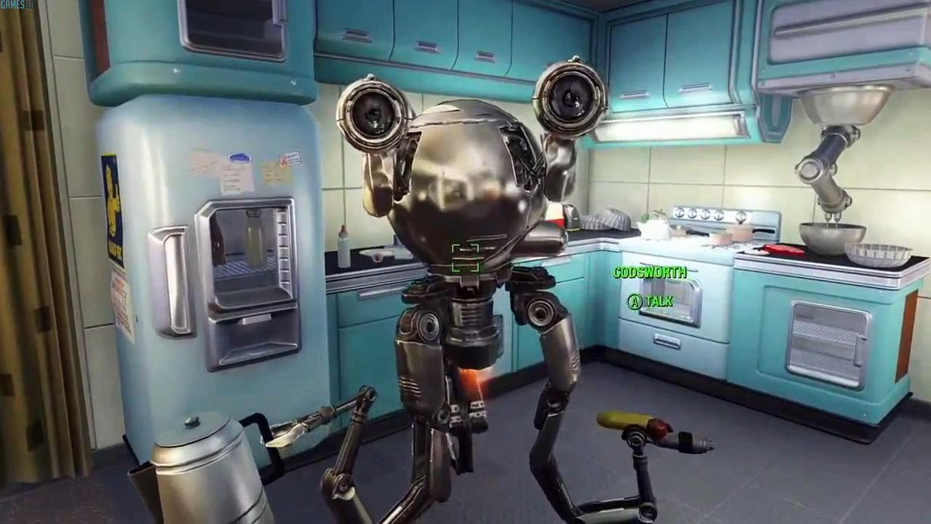

Slide 7
In more detail, computer science is…
Determining what problems can be solved with a computer
Developing step-by-step instructions (algorithms) for solving these problems
Evaluating the efficiency of different algorithms
Expressing and implementing algorithms by using programming languages
Designing and building software that uses algorithms to solve real-world problems
… And many other things!

Slide 8
Computer science is NOT…
Designing computer hardware components
Building or repairing computers
Managing computer networks
Gaining expertise in using specific software (Windows, Linux, Office, Photoshop, etc.)
But… Even though computer scientists aren't involved with designing computers, we should still have a basic understanding of how they work

